Slide 1
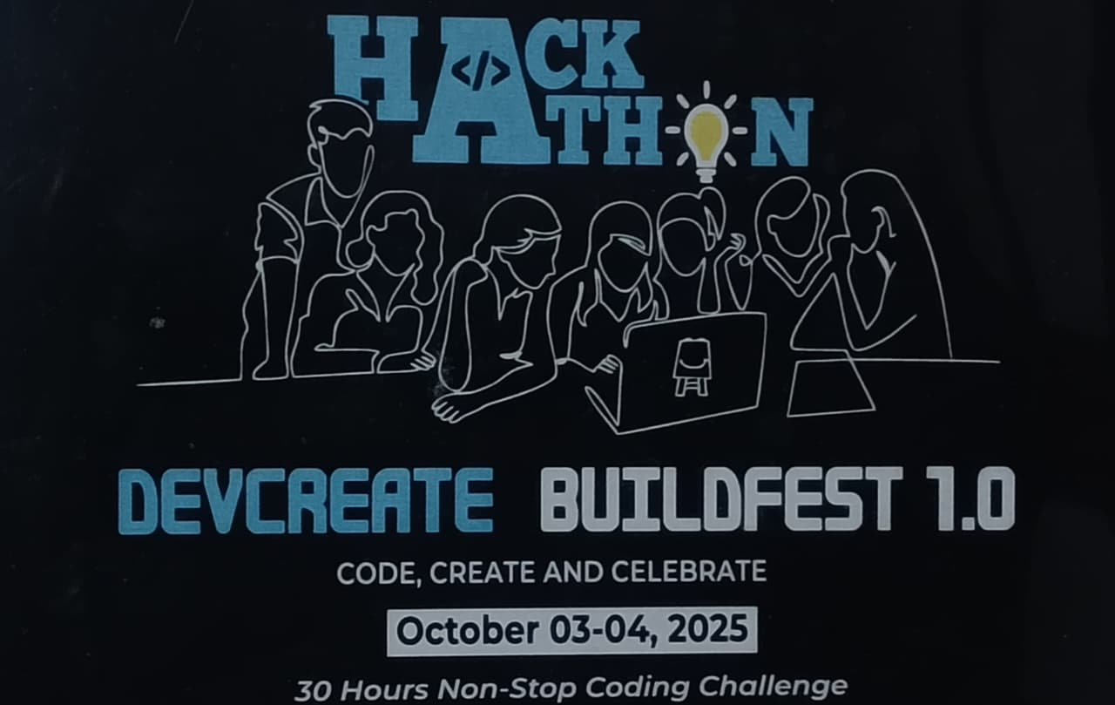
DEVCREATE BUILDFEST 1.0
Problem Statement ID – 08
Problem Statement Title - Smart Crop : Advisory system for Small and Marginal Farmers
Theme - Agri Tech
PS Category - Software
Team ID- T004
Team Name- The Elio’s

Slide 2
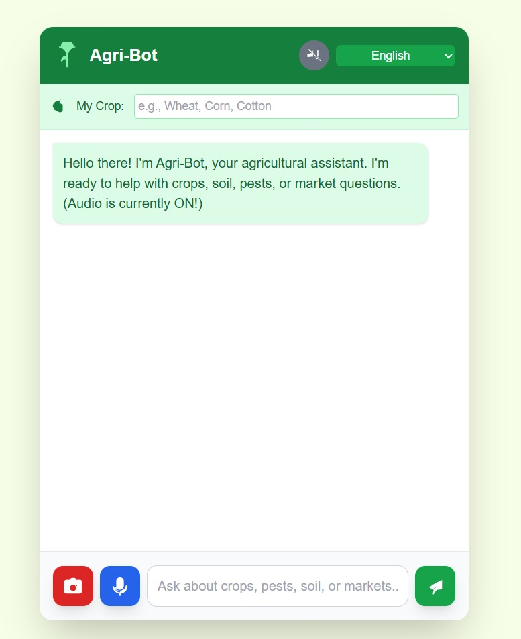
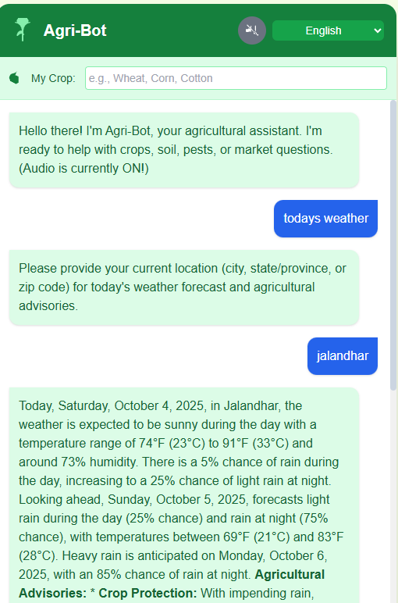
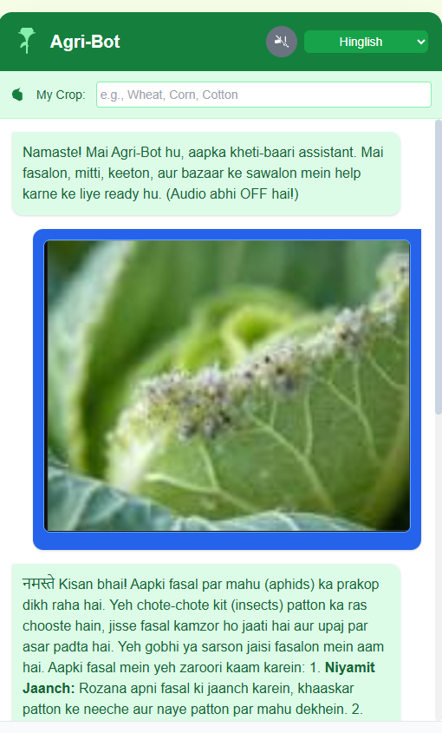
AGRI BOT
PROBLEM :
A majority of small and marginal farmers in India still depend on traditional knowledge, local shopkeepers, or guesswork for making crucial farming decisions like crop selection, pest control, and fertilizer use.
They do not have access to personalized, real-time advisory services that consider their soil type, weather conditions, and crop history. This results in low yields, high input costs, and environmental damage due to overuse of fertilizers and pesticides.
Additional barriers such as language diversity, low digital literacy, and lack of localized Agri-Tech tools further prevent them from accessing modern, data-driven solutions.
SOLUTION :
Agri BOT is a multilingual, AI-powered chatbot designed to empower small and marginal farmers with real-time, location-specific farming guidance.
It addresses the challenges of low digital literacy, language barriers, and lack of localized advisory by delivering simple, farmer-friendly insights directly to cell phones.

Slide 3
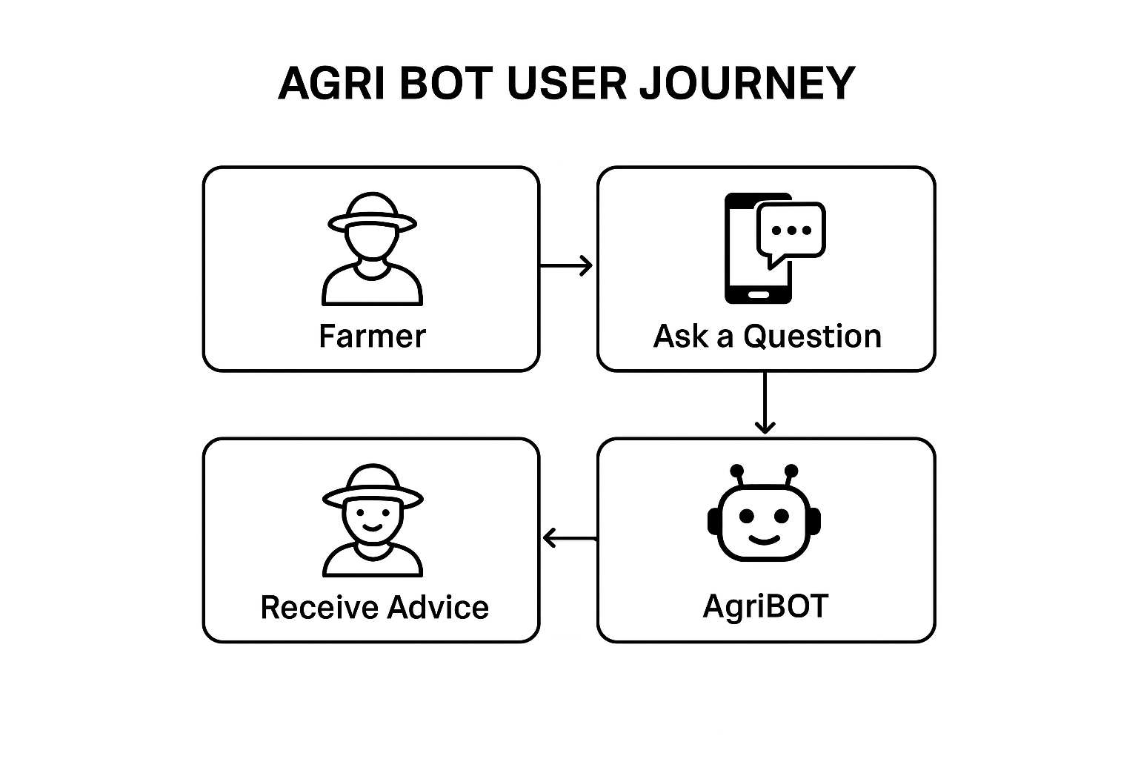
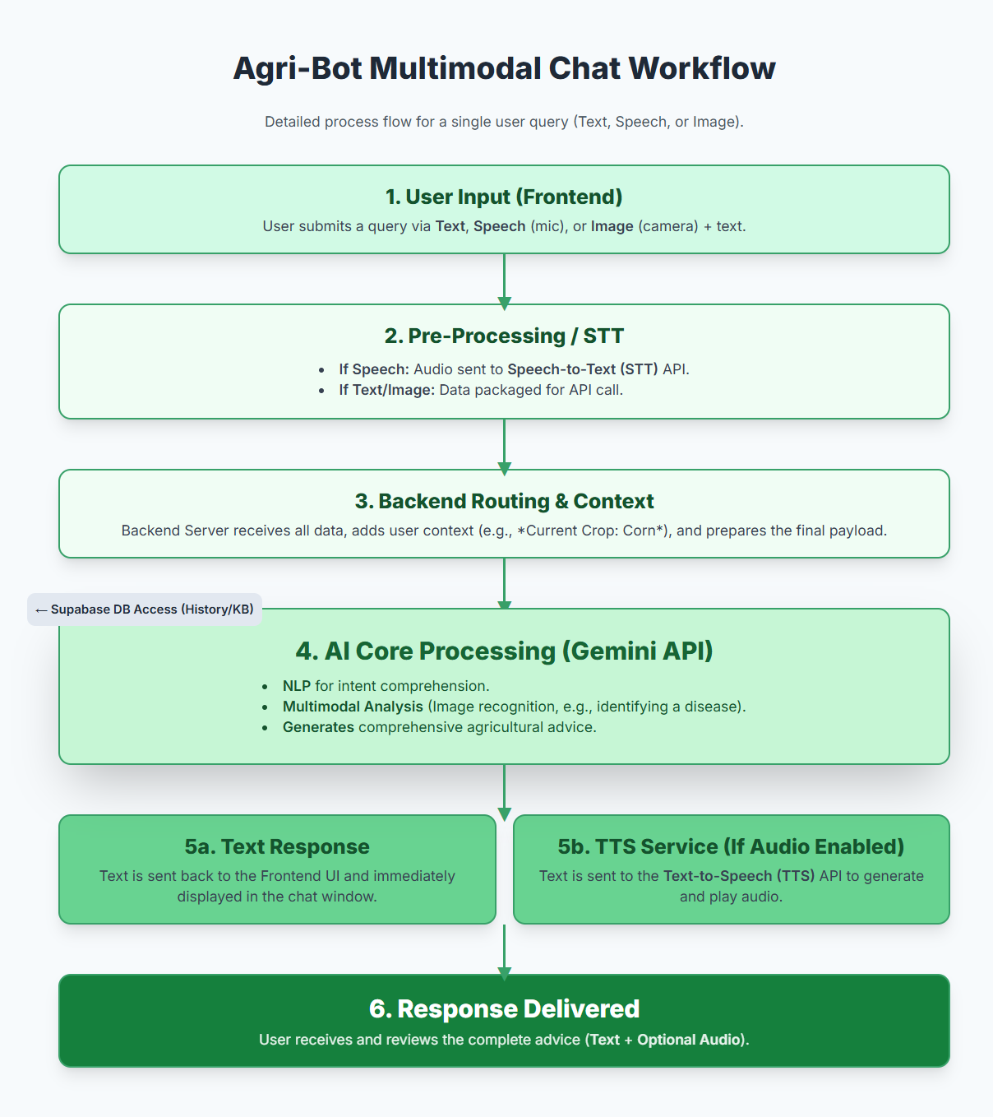






TECHNICAL APPROACH
TECHNOLOGY USED :
Frontend & UI - HTML, CSS , JavaScript (specifically react.js)
Backend & APIs-API layer- Node.js(Express) or Supa base Edge Function
Data & Storage-
Database :Supa base PostgreSQL
Storage: Supa base Storage AWS S3
Hosting -
Frontend hosting: Vercel/ Netlify
Backend hosting: PostgreSQL

Slide 4
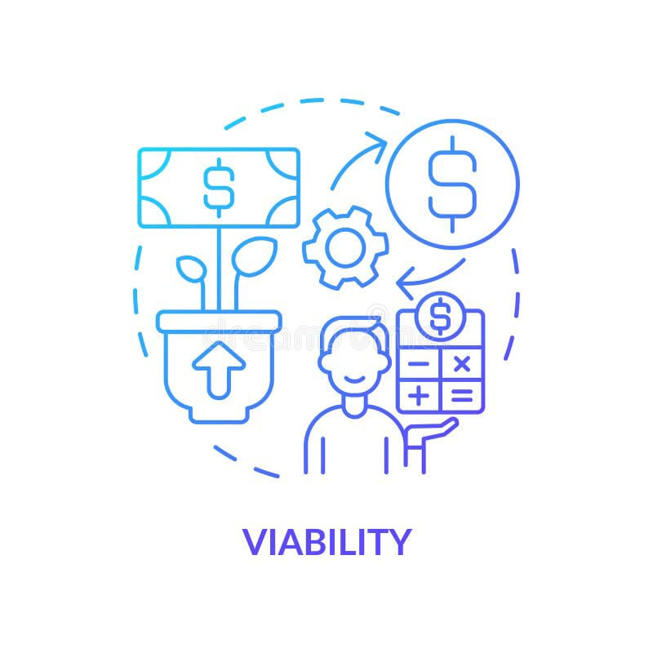

FEASIBILITY AND VIABILITY
Technically Possible – Works on any smartphone, supports voice & local languages, uses proven AI for crop, soil, pest & weather insights.
Affordable & Scalable – Low-cost deployment with cloud/open-source tools; easily scaled across crops, regions, and states.
Farmer-Friendly – Offline-first, simple chatbot/app design, breaking barriers of literacy, language, and connectivity.
Economically Sustainable – Huge user base (100M+ small farmers), freemium model + government/NGO partnerships.
High Impact – Boosts yield, cuts input costs, reduces chemical misuse, ensures fair prices, and raises farmer incomes.

Slide 5
IMPACTS AND BENEFITS
BENEFITS
Personalized Advisory: Farmers get crop, soil, and weather-specific guidance instead of guesswork.
Cost Reduction: Optimized fertilizer/pesticide use lowers input costs.
Higher Yields: Timely and accurate advice improves crop productivity.
Fair Pricing: Market price tracking helps farmers sell at better rates.
Accessibility: Multilingual, voice-enabled, and offline-first features make it easy for all farmers.
Sustainability: Reduces overuse of chemicals, protecting soil health and the environment.
Farmer Empowerment: Farmers make informed, independent decisions rather than relying on shopkeepers.
IMPACTS
Economic Impact: Increases farmer income, reduces debt risks, and contributes to rural prosperity.
Social Impact: Builds farmer confidence, reduces exploitation, and empowers marginalized communities.
Environmental Impact: Promotes sustainable farming, improves soil fertility, and reduces pollution from excessive chemicals.
Technological Impact: Bridges the digital divide in rural India by introducing farmers to AI-driven advisory in their own language.
Policy Alignment: Supports government initiatives like Digital India and Smart Agriculture Missions.

Slide 6
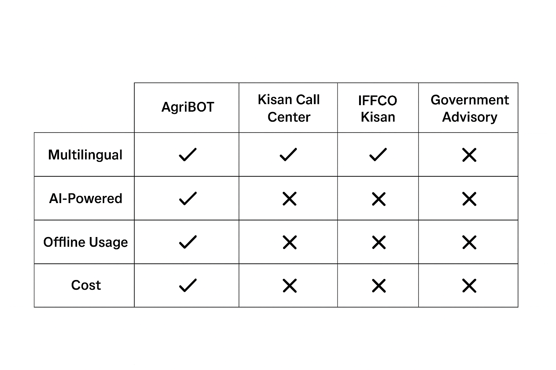
RESEARCH & REFERENCES
The global challenge of food security demands immediate, scalable access to specialized agricultural expertise.
Traditional methods of consulting agronomists are often slow and expensive, creating critical delays when farmers face issues like pest infestation or crop disease.
This Agri-Bot addresses this gap by leveraging Generative AI and Multimodal capabilities (vision, speech, and text).
It allows farmers to upload an image of a diseased crop or speak a query, instantly receiving accurate diagnostic advice, treatment protocols, and educational resources.
Built on a scalable React/Supa base stack and powered by Gemini/GPT for instant, data-driven analysis, the bot delivers expert-level support directly to any mobile device, significantly improving reaction times and crop yield potential.
API Taken From : https://aistudio.google.com/api-keys
Use Perplexity for researches: https://www.perplexity.ai/

